Slide 1
CFS-101 Training Tool What It Is
CFS-101 is a self-guided CFS training SW package.
It is available for download at https://github.com/nasa/CFS-101.
It consists of
an HTML-based, step-by-step Training Guide
a Linux Virtual Machine (VM) used a training workspace
It is intended for
SW developers for a CFS-based project (must know C !)
Co-ops, interns, students (must know C !)
It provides instructions on how to
build & run CFE/CFS system out-of-box
use a simple Ground System to send commands & to receive telemetry
create & integrate an app using a tool to generate its “base code”
customize & add features to an app
re-build & re-run the system

Slide 2
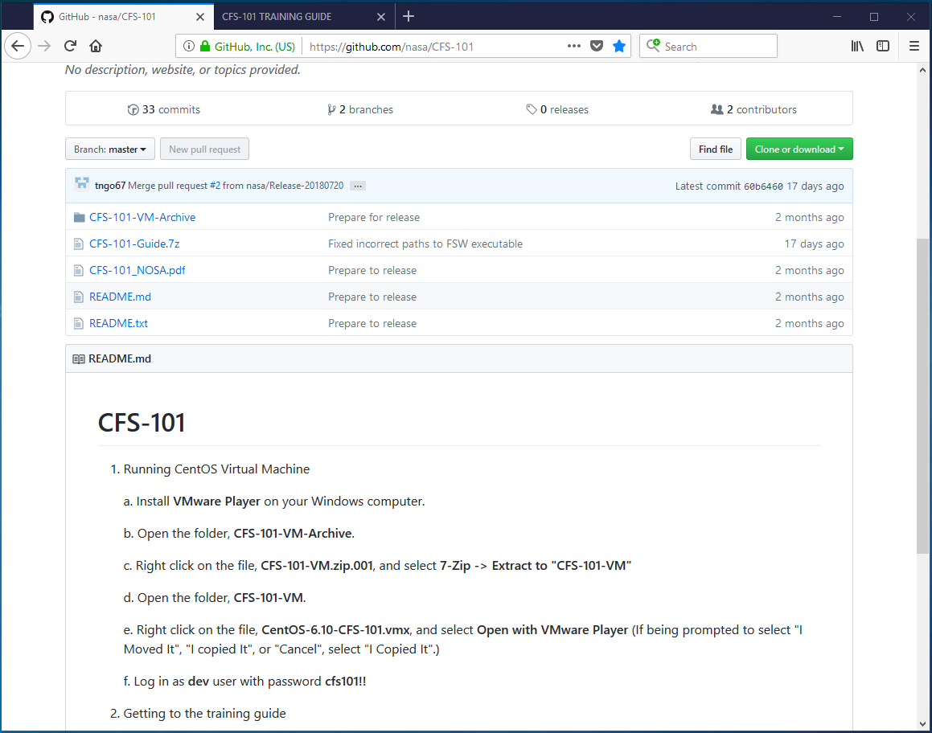
CFS-101 Training Tool (cont.) Repository on GitHub.com
CFS-101 on GitHub

Slide 3
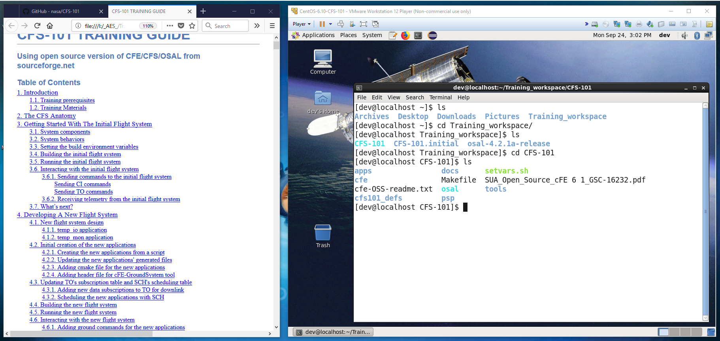
CFS-101 Training Tool (cont.)
Typical Setup on a Windows Laptop/Computer
Training Guide window
Training Workspace inside
a Virtual Machine window

Slide 4
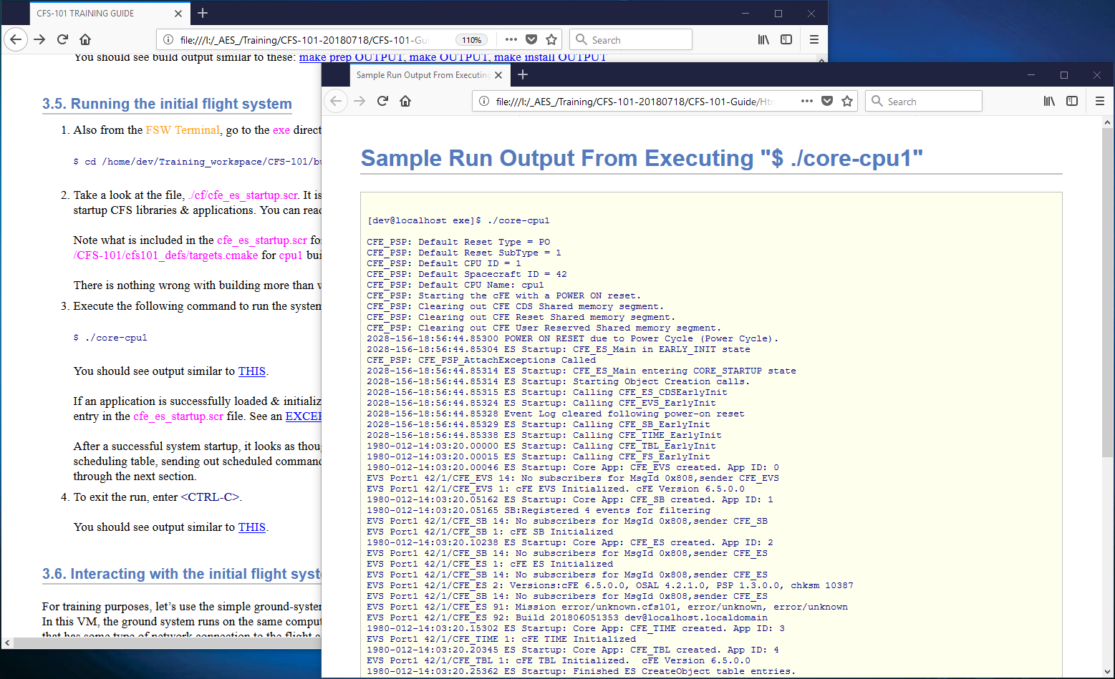
CFS-101 Training Tool (cont.)
Sample of Training Guide Content
Link to the expected output

Slide 5
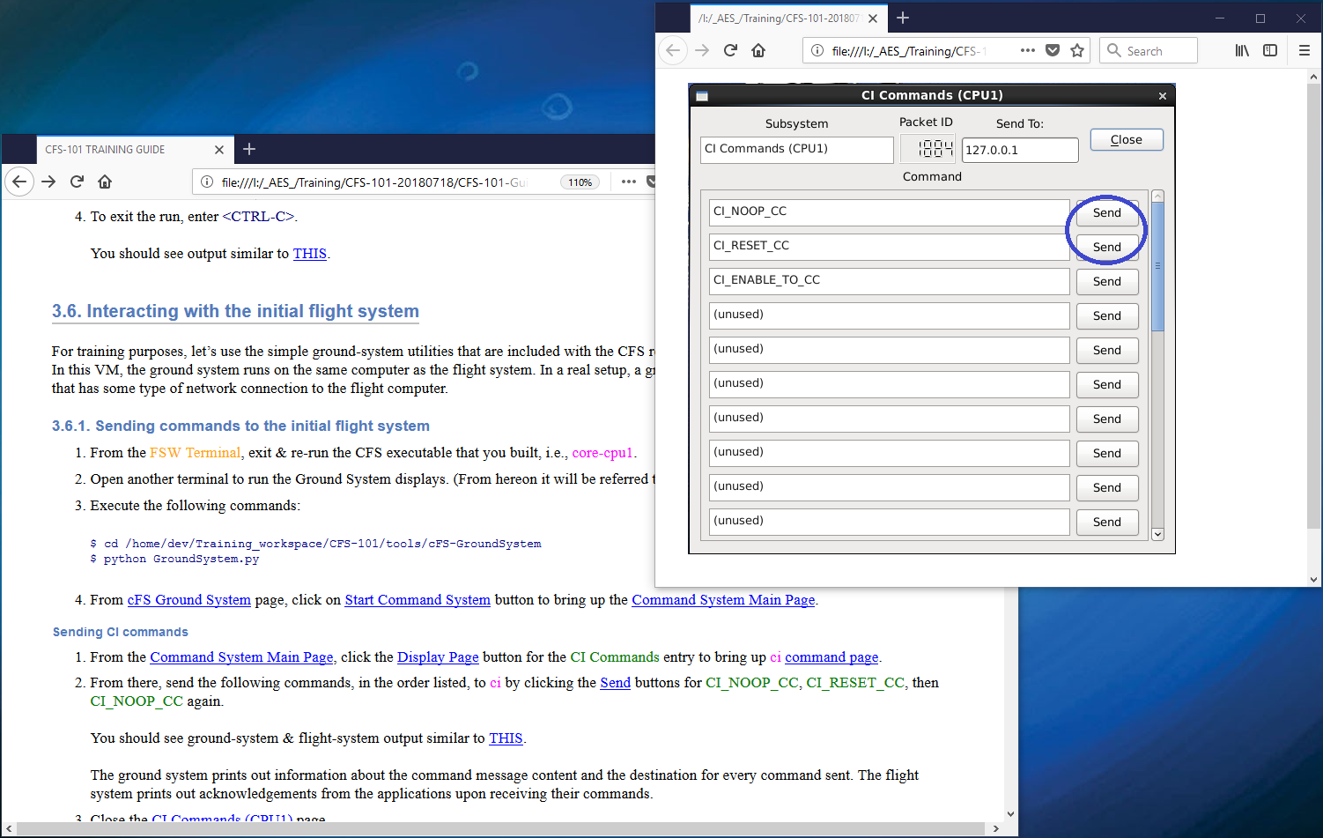
CFS-101 Training Tool (cont.)
Sample of Training Guide Content
Link to the expected display

Slide 6
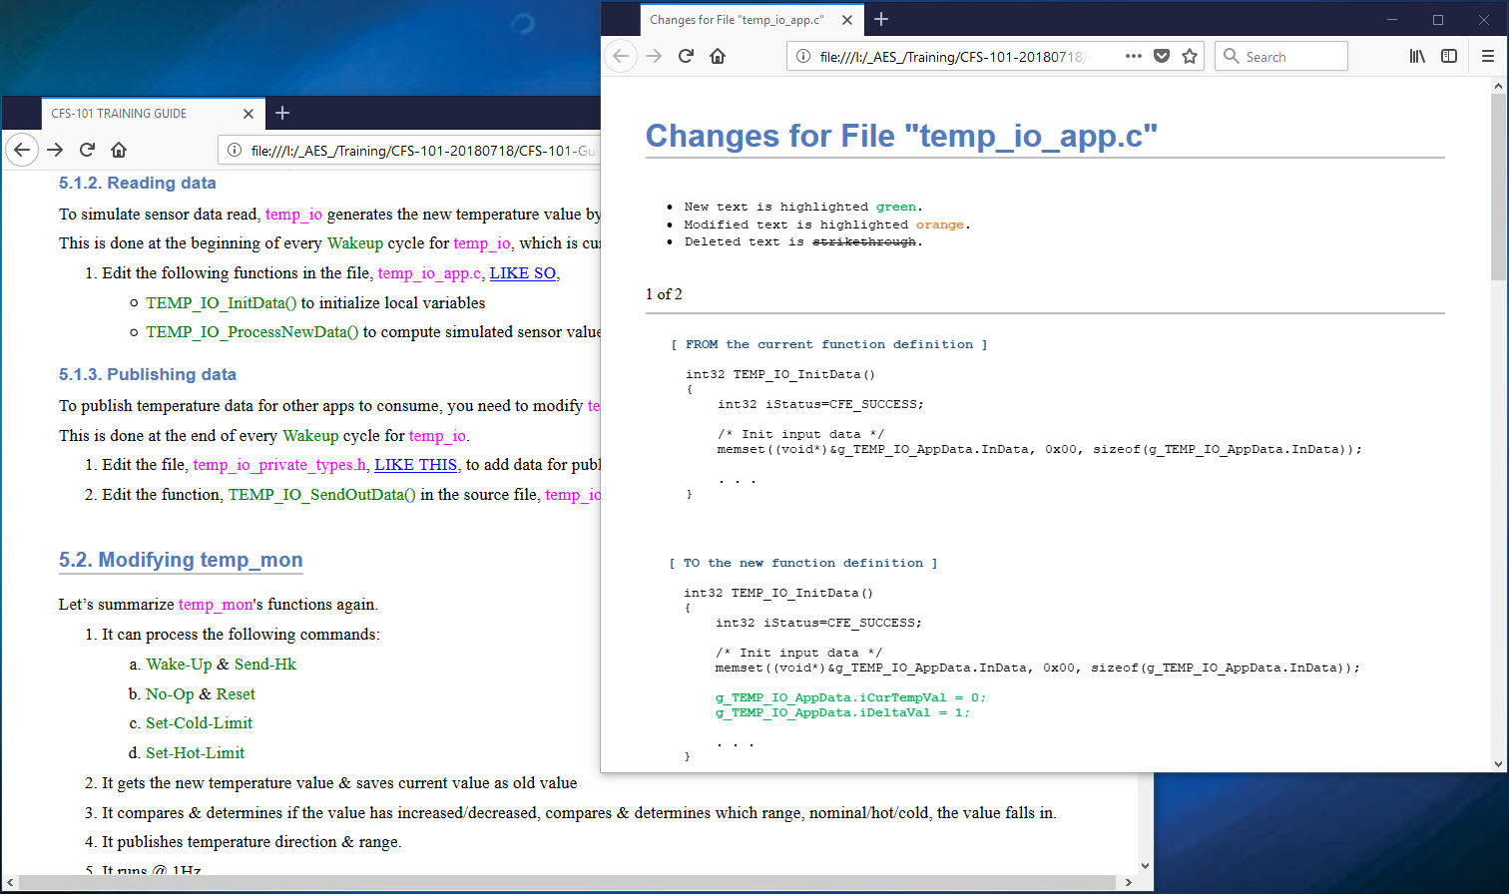
CFS-101 Training Tool (cont.)
Sample of Training Guide Content
Link to expected code updates

Slide 7
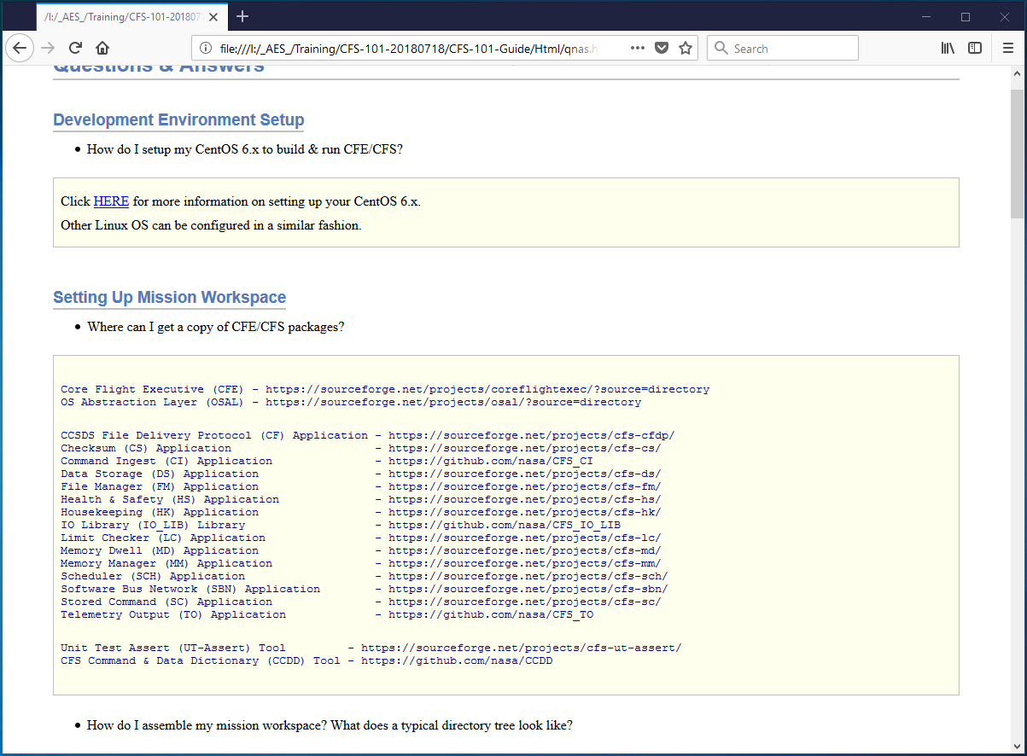
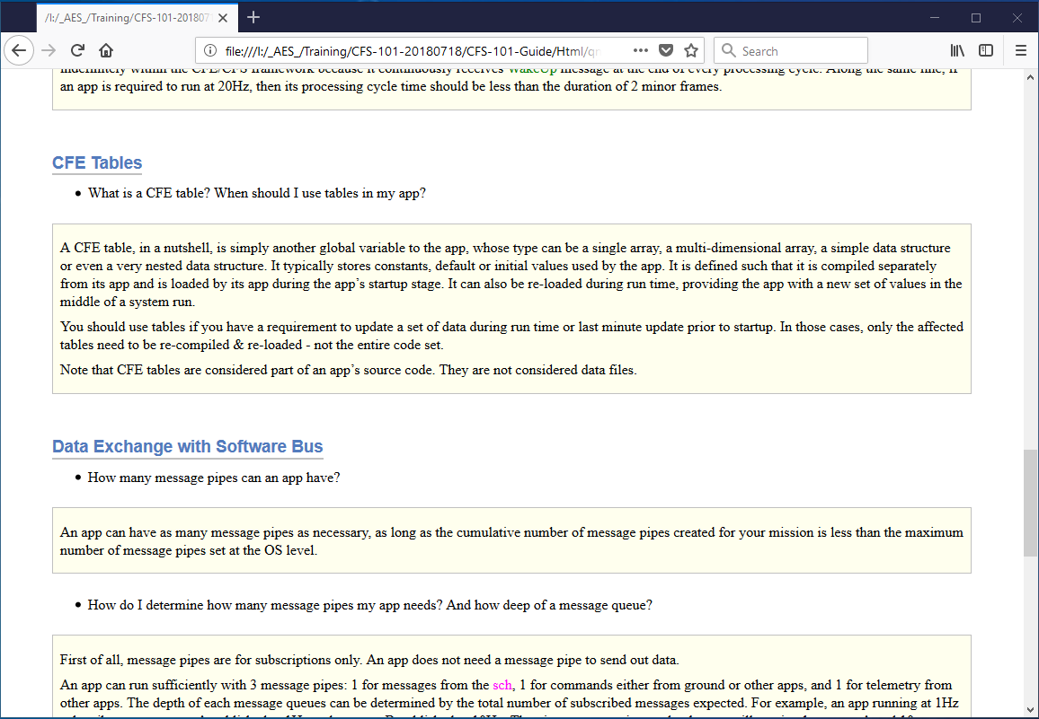
CFS-101 Training Tool (cont.)
Sample of Q&A Section
Questions & Answers section

